Slide 1
Algorithm Analysis
Defining & Evaluating Algorithms

Slide 2
Revision: Properties of an Algorithm
  All algorithms should have the following properties:
    Finite – the algorithm should always terminate
    Defined – Every action the algorithm needs to take should be specifically defined (no fuzziness allowed)
    Inputs – All algorithms should have 0 or more inputs
    Output – All algorithms should have an output
    Effectiveness – An algorithm is expected to work! It should also work in a reasonable amount of time.
How can we tell without running it??

Slide 3
Comparing Algorithms
  We always assume algorithms function correctly
    They should do the job they are designed to do
  To decide on which algorithm to implement as the solution to a problem, we need a way to compare their effectiveness
    This is usually done by comparing the time or space requirements
  One way to compare time/space requirements for an algorithm is to use asymptotic analysis, i.e. the time/space costs when running an algorithm
    Big O: How an algorithm’s requirements grow as input size increases

Slide 4
Comparing Algorithms with Big O
  Big O is about rate of growth
    How an algorithm will perform as it scales up
  Given an algorithm A, how will it perform with a dataset of 3000?
  How will it perform with a dataset of 3,000,000?
  Big O allows us to make a “pure” comparison of algorithms, without worrying about:
    The hardware they’re running on
    Any other “background noise” on the computer executing the algorithms

Slide 5
Big O Analysis
  Big O analysis measures the requirements of an algorithm relative to its input size
    This is referred to as the “complexity” of the algorithm
    Allows us to rate algorithm efficiency/cost so they can be compared
  Big O is always discussed relative to the size of the input
    Major impact factor on how long an algorithm will take to execute!
    We ignore constant values and multipliers because they do not impact the scale of the algorithm’s requirements

Slide 6
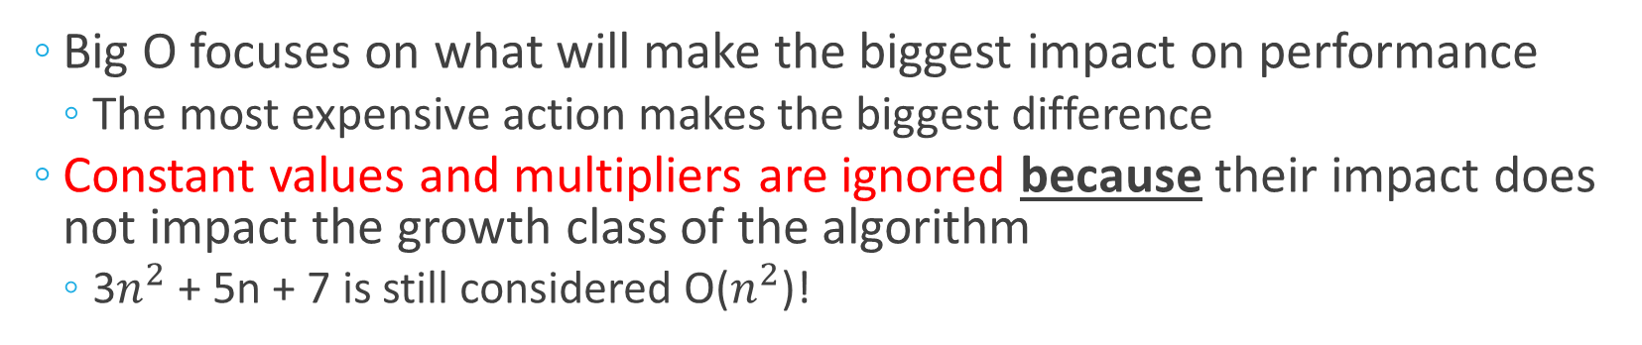
The Big O Simplification Rule:
  Big O focuses on what will make the biggest impact on performance
    The most expensive action makes the biggest difference
  Constant values and multipliers are ignored because their impact does not impact the growth class of the algorithm
    3$n^{2}$ + 5n + 7 is still considered O($n^{2}$)!
  If step 1 of an algorithm takes n iterations to complete & step 2 takes $n^{2}$:
Where n = 10:
    Step 1 takes 10 iterations
    Step 2 takes 100 iterations
    Total cost: 110
Where n = 100:
    Step 1 takes 100 iterations
    Step 2 takes 10000 iterations!
    Total cost: 10100
Where n = 1000:
    Step 1 takes 1000 iterations
    Step 2 takes 1000000 iterations!
    Total cost: 1001000

Slide 7
Common Complexity Values
  O(1) - Fixed
  O(N) - Linear
  O(N²) - Quadratic
  O(log N) - Logarithmic
  O(N log N) - Linearithmic
  O(2^{N}) - Exponential*
Most of what we’ve done so far lives here
We’ll be doing some examples from here soon
Notes:
* Not in the scope of the course

Slide 8
Basic Complexities: Fixed Complexity
  O(1) – Has a constant complexity
  The algorithm/line of code will take the exact same work to complete, regardless of the input size
    Fixed complexity algorithms will never contain non-constant loops
  Example:
    public static boolean hasFirstElement(String [] elements){
    return elements[0] != null;
    }

Slide 9
Basic Complexities: Linear Complexity
  O(N) – has a linear complexity (N, where n is the input size)
  The algorithm/line of code’s time/space requirements will grow linearly in proportion to the input size
    A single for loop iterating from start to end of a data set has linear complexity
  Example:
    public static boolean contains(String [] elements, String e){
    for(String current: elements){
    if(current.equals(e)){
    return true;
    }
    }
    return false;
    }

Slide 10
Another Example of Linear Complexity – Linear Search
  Linear search: checking each element in an array, one after the other
    Only stop when either:
      You find a match
      OR
      You reach the end of the array
  Algorithm in practice:
    for(int i = 0; i < arr.length; i++){
        if(arr[i] == value){
          return i; // Found the value, so return its position
        }
    }
    return -1; // Didn’t find a match in any slot, so return that there was no match
Just like the previous algorithm, go through the entire array once at most

Slide 11
Basic Complexities: Quadratic Complexity
O(N²) – has a quadratic complexity (N² where N is the input size)
  The time/space requirements of the algorithm/line of code are directly proportional to the square of the input size
  Nested loops can multiply complexity when each loop depends on the same input size
    The more nested layers, the higher the power value

Slide 12
Basic Complexities: Quadratic Complexity (2)
  Example:
    public static boolean containsDuplicates(String [] values){
    for(int outer = 0; outer < values.length; outer++){
    for(int inner = outer+1; inner < values.length; inner++){
    if(values[outer].equals(values[inner]))
    return true;
    }
    }
    return false;
    }
Wait, that inner loop isn’t going to n iterations every time…
How is this quadratic?!

Slide 13
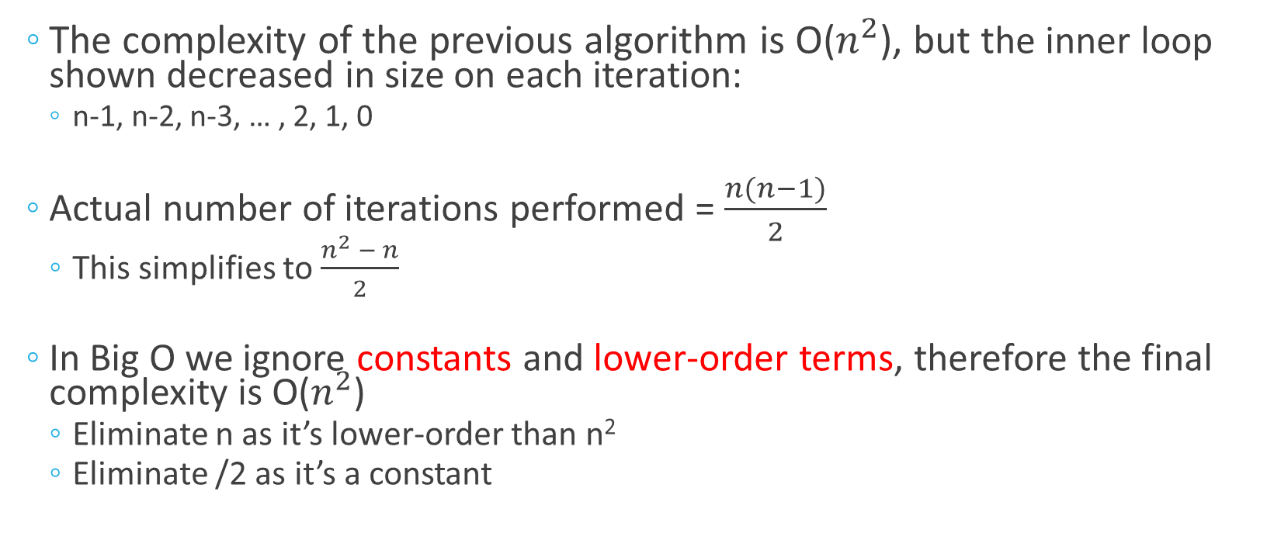
The Maths Behind the Complexity
  The complexity of the previous algorithm is O($n^{2}$), but the inner loop shown decreased in size on each iteration:
    n-1, n-2, n-3, … , 2, 1, 0
  Actual number of iterations performed = $\frac{n(n−1)}{2}$
    This simplifies to $\frac{n^{2} − n}{2}$
  In Big O we ignore constants and lower-order terms, therefore the final complexity is O($n^{2}$)
    Eliminate n as it’s lower-order than n²
    Eliminate /2 as it’s a constant

Slide 14
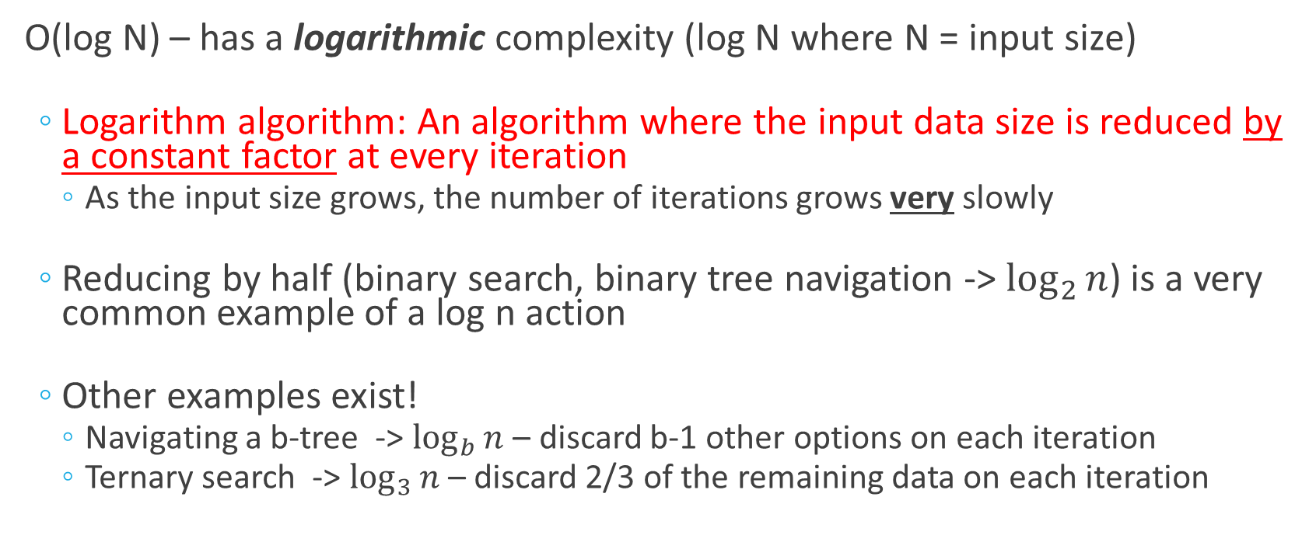
Complex Complexities: Logarithmic Complexity
O(log N) – has a logarithmic complexity (log N where N = input size)
  Logarithm algorithm: An algorithm where the input data size is reduced by a constant factor at every iteration
    As the input size grows, the number of iterations grows very slowly
  Reducing by half (binary search, binary tree navigation -> $\log_{2}{n}$) is a very common example of a log n action
  Other examples exist!
    Navigating a b-tree -> $\log_{b}{n}$ – discard b-1 other options on each iteration
    Ternary search -> $\log_{3}{n}$ – discard 2/3 of the remaining data on each iteration

Slide 15
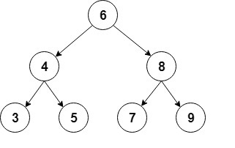
Logarithmic Complexity - Example
  Navigating a binary tree:
    At each step, we choose a side
    The remaining data on the other side is discarded
    This discards half the remaining data each time
  How many iterations/comparisons would be required to navigate this tree?

Slide 16
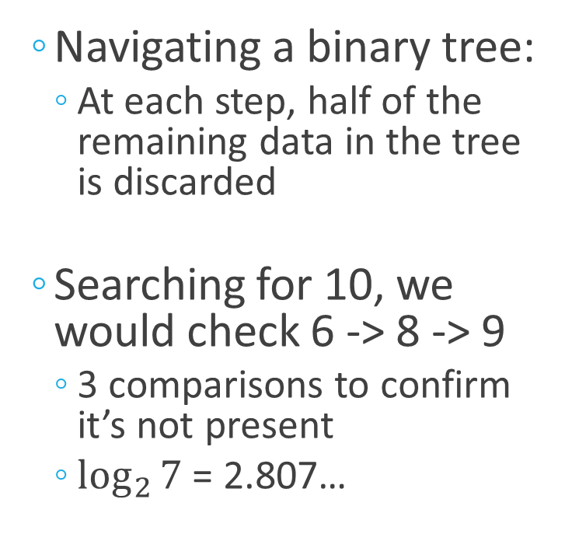
Logarithmic Complexity - Example
  Navigating a binary tree:
    At each step, half of the remaining data in the tree is discarded
  Searching for 10, we would check 6 -> 8 -> 9
    3 comparisons to confirm it’s not present
    $\log_{2}{7}$ = 2.807…

Slide 17
Complex Complexities: Linearithmic Complexity
  O(N log N) – Linearithmic complexity
    Linearithmic: A logarithmic section of the algorithm (where data is repeatedly divided in half) is done a linear amount of times
  Example: Merge sort
    Repeatedly divide data in half until end of data is reached (log N)
    Once data has been fully divided up, merge it back together in order (N iterations)
Notes:
Awareness only!

Slide 18
Complex Complexities: Exponential Complexity
O(2^{N}) – Exponential complexity (2^{N} where N is the input size)
  The opposite to logarithmic complexity – growth doubles with every addition to the size of the input
    Growth starts off slow and then increases at a very high rate!
  Example:
    public static int fibonacci(int num){
    if(num <=1 ){
    return num;
    }
    else{
    return fibonacci(num-1) + fibonacci(num-2);
    }
    }
This is recursion, i.e. when you call a method from within itself
Notes:
Awareness only!

Slide 19
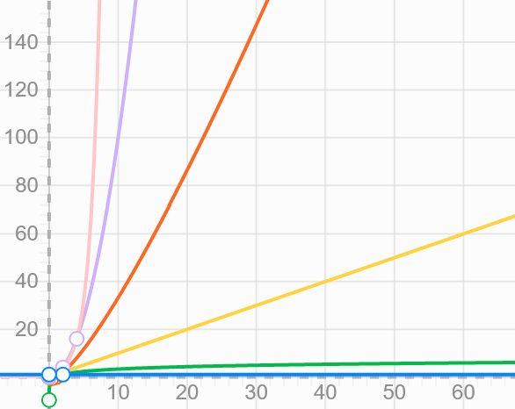
Comparing Complexities
  Fixed/constant time is usually best
  At low input sizes, there is very little difference in complexities
  When input size increases, best to aim for logarithmic complexity
Quadratic
Exponential
Linearithmic
Number of operations
Linear
Logarithmic
Constant
Growth of input (n)

